Slide 1



VASAVI COLLEGE OF ENGINEERING (AUTONOMOUS)
IBRAHIMBAGH, HYDERABAD – 500 031
ACCREDITED BY NAAC WITH 'A++' GRADE
Department of Information Technology
Please adhere to the given template.
Teams can submit ideas for multiple domains.
The last date for submission of the presentations is 17th March, 11:59pm
2.0
In association with:

Slide 2
IDEA TITLE
Team ID: TSH2109
Branch & Year: IT , 3rd Year
Institution: Vasavi College Of Engineering
Location: Hyderabad
Domain: Student Innovation
Problem Statement: Proposing a virtual fitting room system utilizing computer vision and 3D modeling for personalized fashion experiences.

Slide 3
About your Idea
We are enhancing the actual purpose of online shopping by introducing the virtual 3D model
Our project introduces a virtual fitting room system that accurately reconstructs 3D body shapes from 2D images and simulates clothing items onto these models.
Our project mainly focuses on processing the input image and extract relevant features such as body shape , size, race , pose.
We create an user interface for seamless interaction and virtual try-on of clothing items
We implement methods to adjust the size of clothing items to match the dimensions of the 3D model
The user can access various try-ons with different clothing options, eliminating the need to physically visit stores

Slide 4
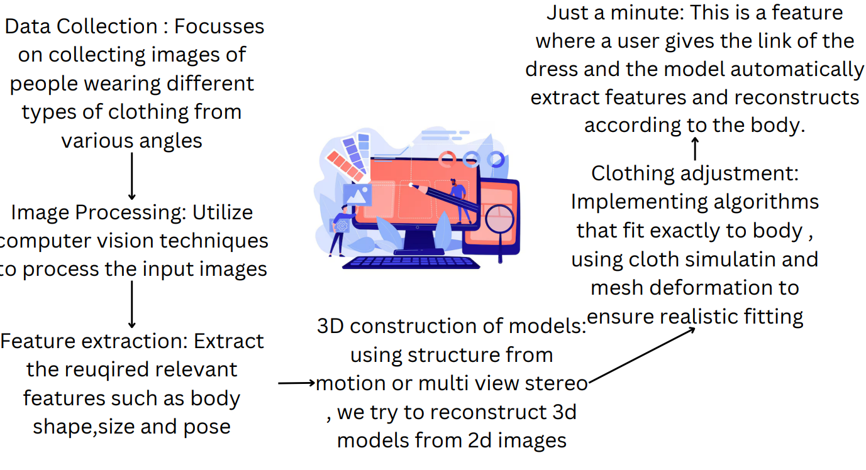
Work Flow

Slide 5
Use cases
Tech Stack
→Image processing
→Feature extraction
→3D body reconstruction
→Virtual Clothing Try-On
→ 360-Degree View
→Size Adjustment
→Realistic Rendering
→Pose adjustment
Front End:React.js
Back End: Django
Libraries: OpenCV,TensorFlow,PyTorch
3D constructor tools: OpenSfM
Web based simulation: Three.js

Slide 6
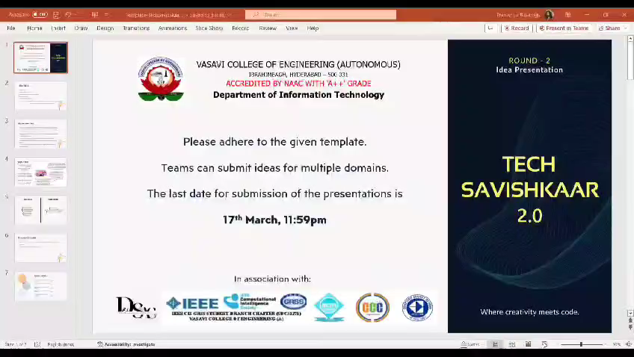
Video Explanation

Slide 7

Team Details
Team Leader: Praneetha Balanagu
Branch: IT Year: 3rd
Team Member 1: Bhuvana Sunkara
Branch: IT Year: 3rd
Team Member 2: Sreshta Reddy
Branch: IT Year: 3rd
Team Member 3: Anushka Cheruku
Branch: IT Year: 3rd
Team Member 4: Shriya Kiran
Branch: IT Year: 3rd

